Slide 1
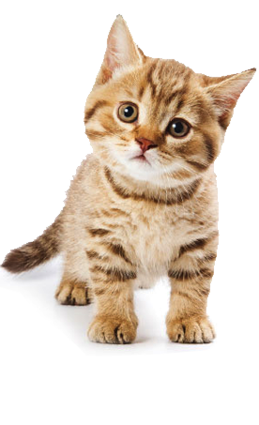
(definition) A four-legged animal that says “meow”
(word) Cat
(picture)
(review question)
What animal says “meow”?

