Slide 1
2.4 The War of 1812

Slide 2
Background Information
●1808 James Madison becomes president.
●1811- Congress has a lot of War Hawks (John Calhoun and Henry Clay) who want to declare war on Britain to restore national honor.
●Wanted to invade British owned Canada.
●1812 Madison convinces Congress to declare war on the world’s strongest power.

Slide 3
War
●Jefferson believed it would be easy but the US lost many battles in Canada mostly b/c the US did not have a trained army.
●US ends up embarrassed by the army but navy did very well.
●Britain took the capital, burned the White House as revenge.
●When Brit. went to attack Baltimore they were defeated.
●(Star Spangled Banner was written by Francis Scott Key)
●US did not conquer Canada but defeated British Indian allies and pushed the British back to Canada.

Slide 4
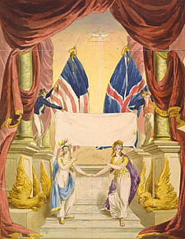
Treaty of Ghent
●US and Britain signed the Treaty of Ghent in Belgium—this marks end of war.
●Britain is also in battle with Napoleon in Europe.
●War of 1812 brought nationalism to the nation as well as faith in the republic.
●Federalists were weakened because they were against a popular war.
●Federalist Party was dead by 1820

Slide 5
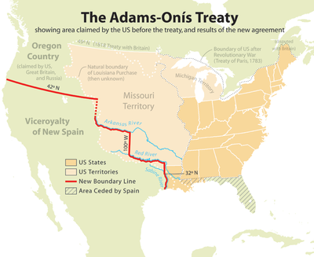
New States
●Indiana—1816
●Mississippi—1817
●Illinois—1818
●Alabama—1819
●Many Americans are going into Spanish owned Florida and US gains the territory in 1819 in the Adams-Onis Treaty

