Slide 1
To fill in your notes
Fill in the center section for what you think each amendment means.
Using this PowerPoint, write in what each amendment actually means.

Slide 2
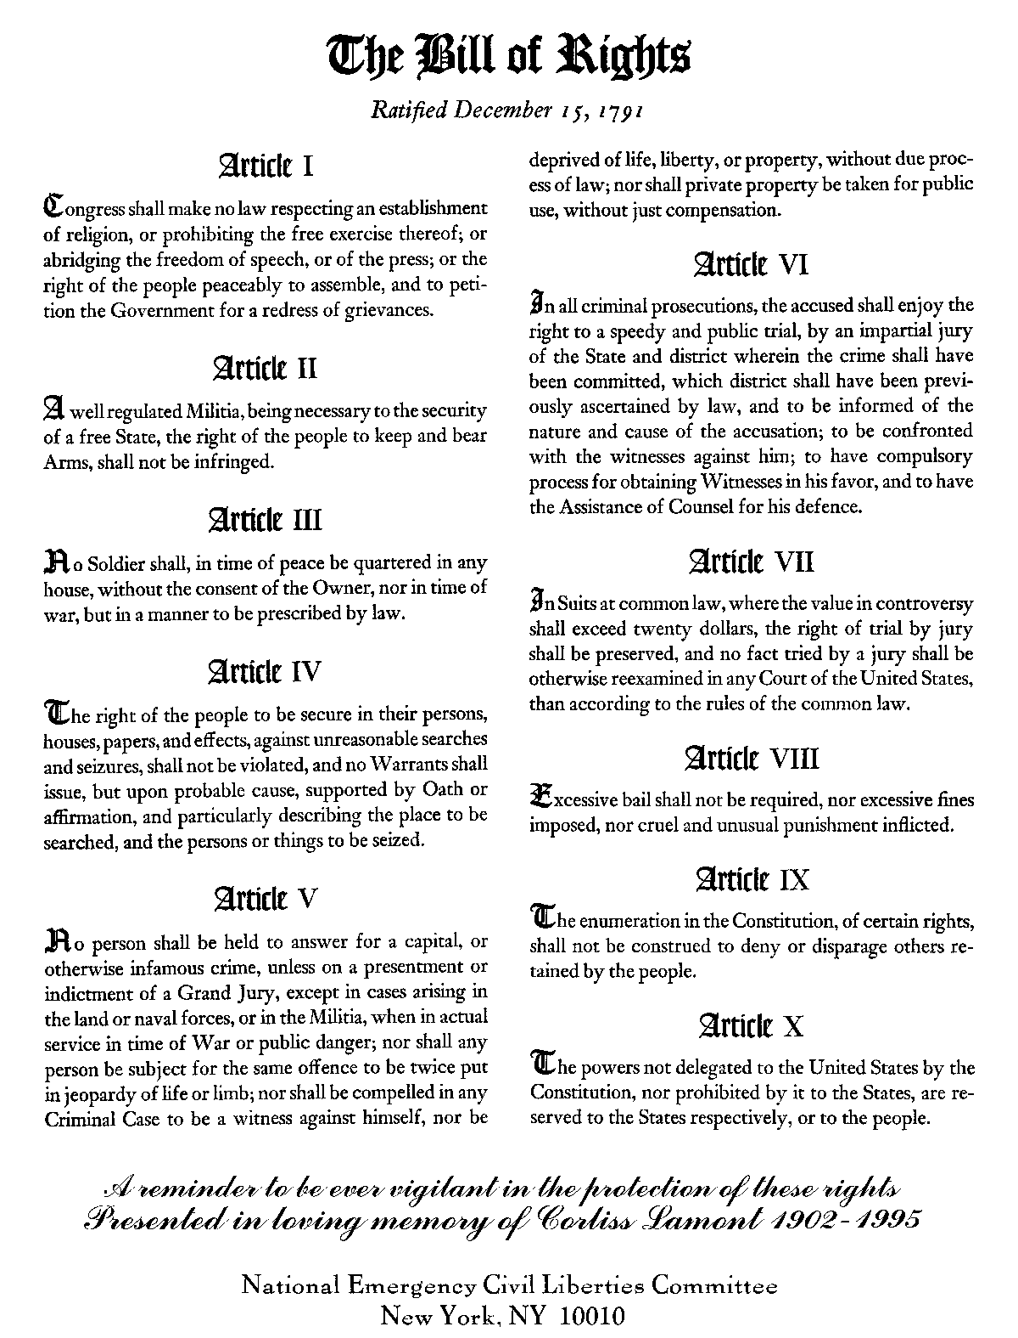
The Bill of Rights - 1st ten amendments to the Constitution --designed to protect our individual liberties.
Bill of Rights

Slide 3



Bill of Rights
Amendment 1
a. Freedom of Religion or not to have a religion. People may worship or not worship as they please.
The government cannot favor one religion over another.
b. Freedom of speech – this freedom is restricted if it harms others. We have laws against slander [spoken] or
libel [written statements] intended to damage ones reputation.
Speech that endangers the safety of the nation [military secrets] may be punished.
Notes:
3

Slide 4


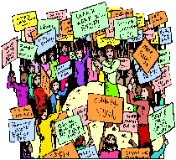


Amendment 1 [continued]
c. Freedom of the Press means we can write our opinions and circulate them to others through T.V., newspapers, or magazines.
d. Freedom of assembly (peacefully).
e. Freedom to petition government officials. You can get people to sign a petition and send it to government officials.
Notes:
4

Slide 5


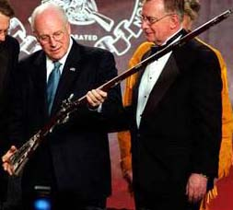
Amendment 2
Amendment 2. Right To Keep And Bear Arms
The purpose was to prevent Congress from denying States the right to have an army of armed citizens. The States and federal government can regulate (control) the possession and use of firearms by individuals.
Notes:
5

Slide 6
NO QUARTERING – (providing food and shelter) of troops
The 3 3rd Amendment - "No soldier shall, in time of peace be quartered in any house, without the consent of the owner, nor in time of war, but in a manner to be prescribed by law."
This place looks great!! I think I’ll move in.

Slide 7

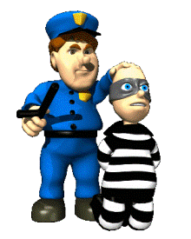




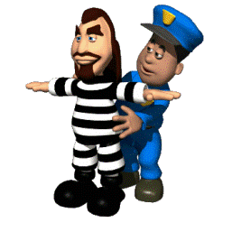
Bill of Rights
AMMENDMENT 4. Limits The Conditions Under Which Police May Search for and Seize (take) Evidence and People
A. No “Fishing Expeditions” by public officials [a search must be reasonable and based on probable cause].
B. In most cases, a search or arrest warrant will be necessary. The warrant must describe the specific place to be searched and the persons or things to be seized.
C. A police officer may chase a suspect into his house & not secure a warrant (this would be probable cause).
D. The Supreme Court has ruled that evidence gained as a result of an unlawful search or seizure cannot be used at the trial.
Notes:
7

Slide 8




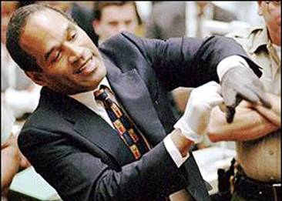

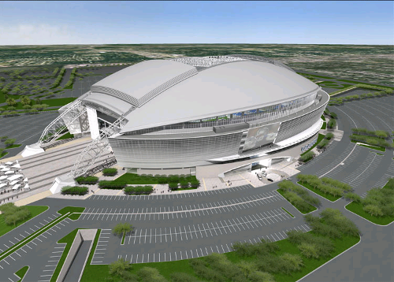
AMMENDMENT 5. Rights of Accused Persons
A. A person can be tried for a serious crime only if he has been accused of that crime by a grand jury.
B. No one may be tried twice for the same offense. [Double Jeopardy clause] – no one may be put in jeopardy twice for the same offense]
C. No one may be forced to testify against himself
or his spouse. You don’t have to answer questions by the police or the courts. [Plead the “5^{th”}]
D. Due Process: No one can be deprived of life, liberty, or property without due process of law [fair and equal treatment under the law].
E. The government may take private property for a legitimate public purpose; but when it exercises that power of EMINENT DOMAIN [taking property for public use], it must pay a fair price.
New Cowboys stadium
meant property losses.
Notes:
8

Slide 9
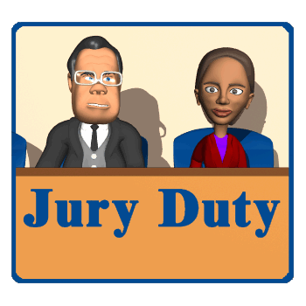
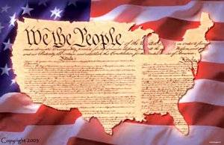
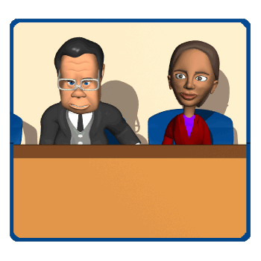

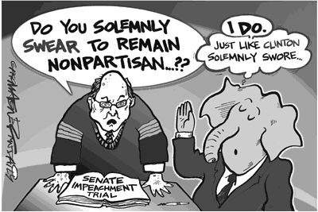
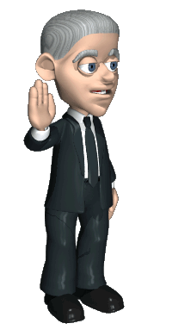

Amendment 6. Right To A Speedy Trial
A. IMPARTIAL JURY. You do not have to use a jury and can have the case transferred if it has received too much publicity.
B. Right to be told what crime you are accused of.
C. Right to hear and question all witnesses against you.
D. The right to compel [require their testimony] witnesses to appear at a trial to tell your side of the story.
E. Right to a lawyer.
Notes:
9

Slide 10

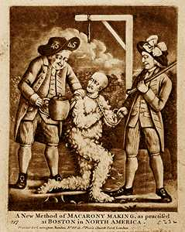
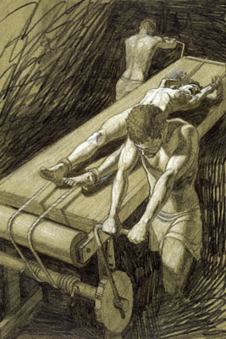
AMMENDMENT 7 - Jury Trial In Civil Cases in
disputes in excess of $20.
AMMENDMENT 8 - No Excessive Bail or Fines, or “Cruel and Unusual Punishment” [like torture and beheading]
Tar and
Feathering
The
“Rack”
Notes:
10

Slide 11
This is supposed to mean that if the rights were not spelled out specifically in the Constitution, then those rights belonged to the people. For example, the Constitution has nothing in it about who you use for your Internet service provider. Therefore, the government cannot deny you that choice.
The 9th Amendment - “The enumeration in the Constitution, of certain rights, shall not be construed to deny or disparage others retained by the people.”
9th Amendment:
WOW!! You mean I get even more rights than what is in the Bill of Rights?!?!?

Slide 12
If the rights were not spelled out specifically in the Constitution,
then those rights belonged to the states.
For example, the constitution is silent about driving a car.
The power to grant licenses for driving is left to the states. Which is why you can drive a car at 15 in S.C.
but not until 16 in Ohio.
The 10th Amendment – “The powers not delegated to the United States by the Constitution, nor prohibited by it to the States, are reserved to the States respectively, or to the people.” Meaning…
10th Amendment
FEDERALISM
FEDERALISM

