Slide 1
Primary and secondary sources

Slide 2
What are Primary Sources?
A primary source is a document or physical object which was written or created during the time under study. These sources were present during an experience or time period and offer an inside view of a particular event.
Some types of primary sources include:
ORIGINAL DOCUMENTS (excerpts or translations acceptable): Diaries, speeches, manuscripts, letters, interviews, news film footage, autobiographies, official records
CREATIVE WORKS: Poetry, drama, novels, music, art
RELICS OR ARTIFACTS: Pottery, furniture, clothing, buildings

Slide 3
What are Secondary Sources?
A secondary source interprets and analyzes primary sources. These sources are one or more steps removed from the event. Secondary sources may have pictures, quotes or images in them. Some types of secondary sources include:
PUBLICATIONS: Textbooks, magazine articles, histories, criticisms, commentaries, encyclopedias
Examples:
A journal/magazine article which interprets or reviews previous findings
A history textbook
A book about the effects of WWI

Slide 4
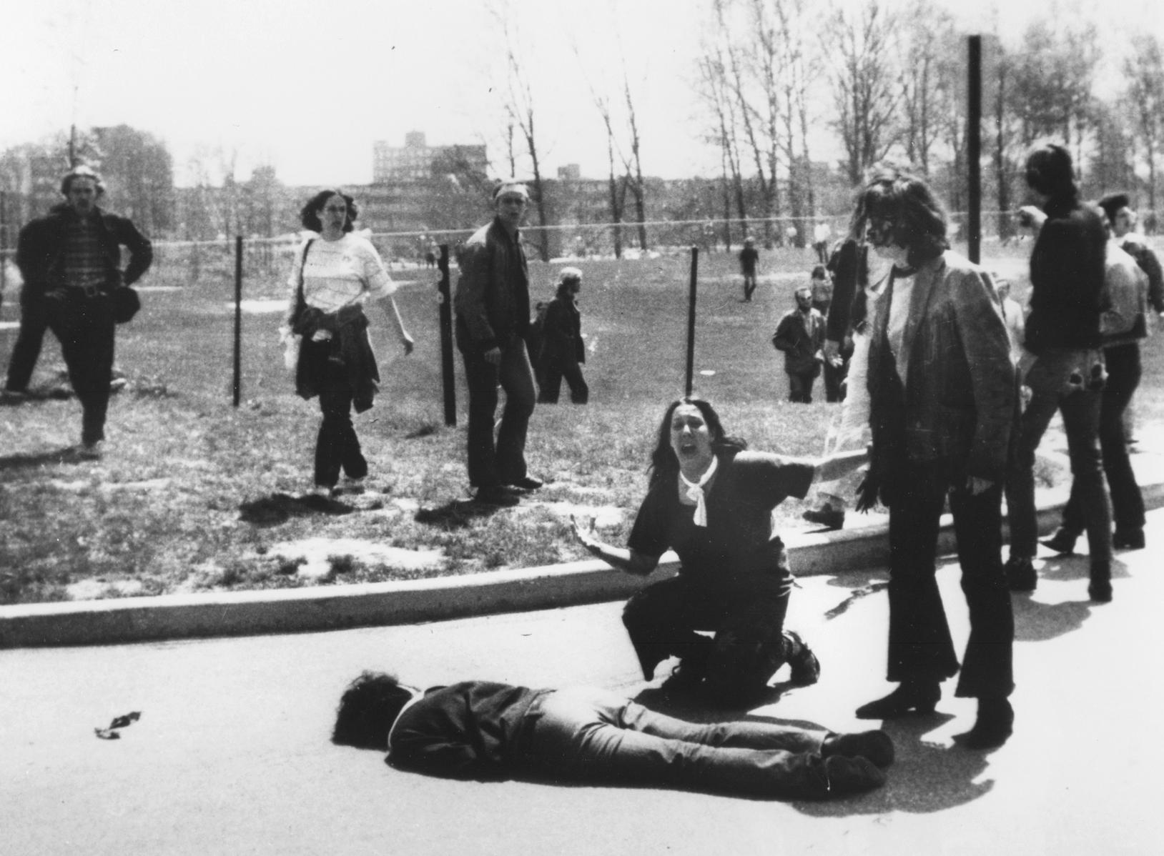
Notes:
Kent state shooting in Kent, OH-unarmed college students were fired upon by the OH National Guard in 1970.
Fired 67 rounds in 13 seconds
Students were protesting Cambodian Campaign (series of military operations in Cambodia during Vietnam), some were just passersby
Led to many schools shutting down due protests

Slide 5
Fortieth Congress of the United States of America;
At the third Session, Begun and held at the city of Washington, on Monday, the seventh day of December, one thousand eight hundred and sixty-eight.
A Resolution Proposing an amendment to the Constitution of the United States.
Resolved by the Senate and House of Respresentatives of the United States of America in Congress assembled, (two-thirds of both Houses concurring) that the following article be proposed to the legislature of the several States as an amendment to the Constitution of the United States which, when ratified by three-fourths of said legislatures shall be valid as part of the Constitution, namely:
Article XV.
Section 1. The right of citizens of the United States to vote shall not be denied or abridged by the United States or by any State on account of race, color, or previous condition of servitude—
Section 2. The Congress shall have the power to enforce this article by appropriate legislation.
Notes:
15th Amendment

Slide 6
