Slide 1
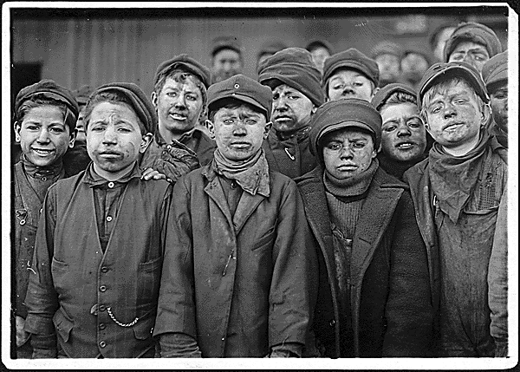
http://www.archives.gov/education/history-day/online.html
Breaker boys. Smallest is Angelo Ross. Hughestown Borough Coal Co. Pittston, Pa.

