Slide 1
Warm Up
On a piece of paper in your binder, please answer:
What does INSPECT stand for? Tell me about how we will be tracing these themes throughout the course.

Slide 2
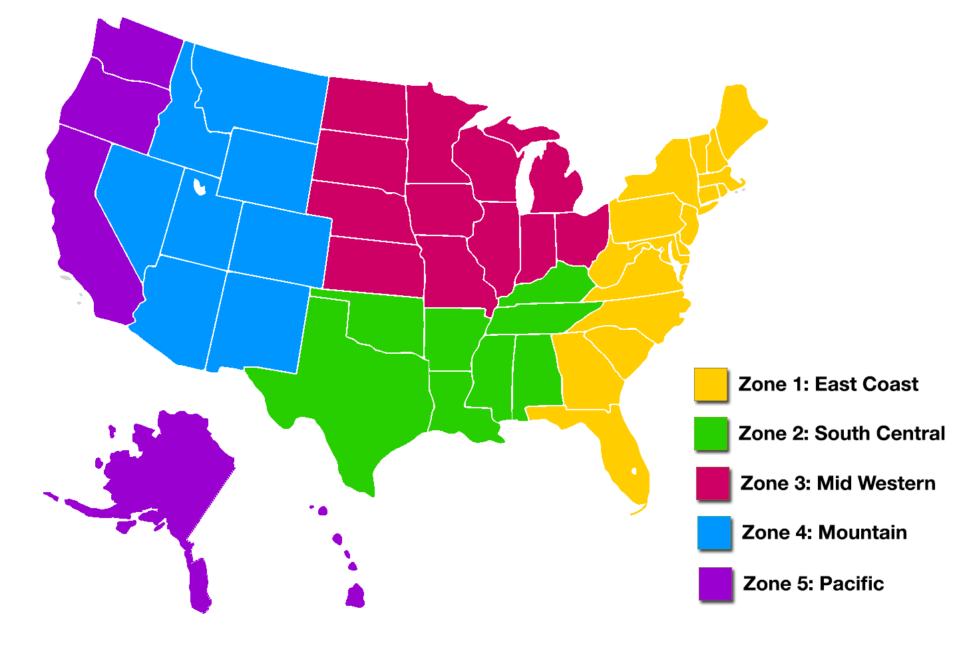

Slide 3
Foldable
Six flaps
Name of region on top of flap
Description underneath
You come up with: an example city/state in each region

Slide 4
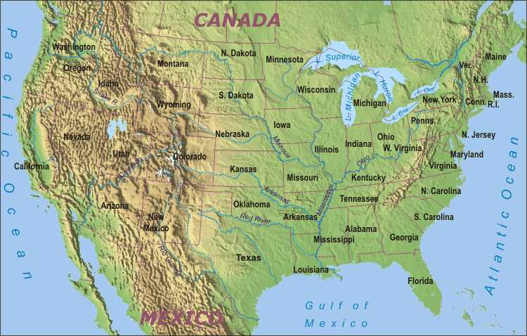

Slide 5
For each region, we must consider what people will need in terms of:
Food
Clothing
Shelter
Hint: Write this down on your paper!! We will all share with the class

Slide 6
Sporcle.com

Slide 7
Exit Ticket
What is one state from the Mountain region?
What region do we live in (NC)?
What is one state (and what region is it located in) that you would like to visit and why?
What are you confused about from today’s lesson, or what will you need help with to better understand?

