Slide 2
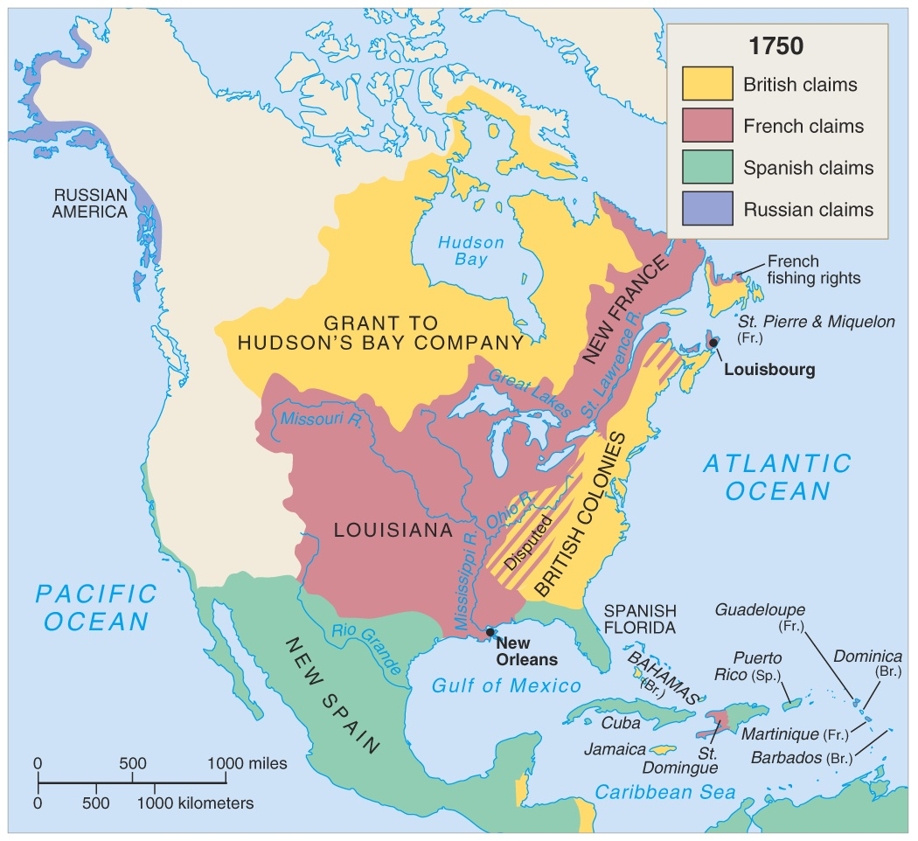
North America-1750
Notes:
Land disputes btwn British and French in Ohio River valley

Slide 3
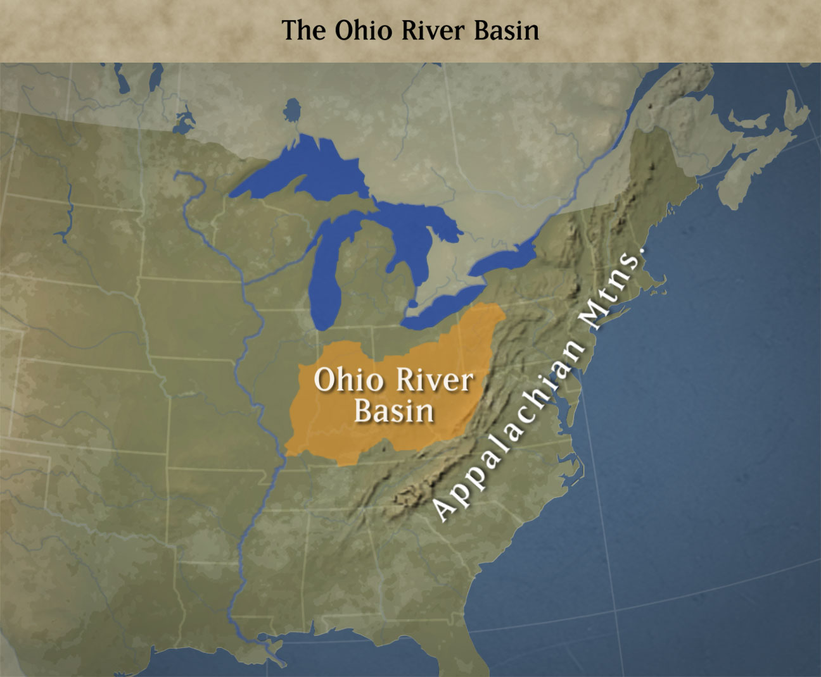
Rising Tensions
By 1700, the English and the French were competing for North America
Expansion of French influence into the Ohio Valley and along the Appalachians alarmed the English
Both sides dependant upon Indian allies
Notes:
French have Native American allies—trade w/ them

Slide 4
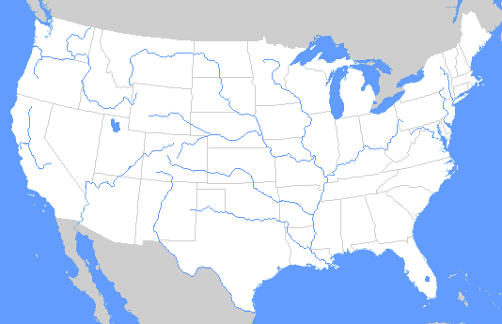
Lead up
No definite document stating who controlled Ohio River Valley
After Virginia took control of disputed land, the French retaliated by building a chain of forts (from St. Lawrence River to the Mississippi)
Washington tries to capture Fort Duquesne and fails. This leads to the British declaring war on France
Notes:
Virginia took control of land in disputed territory
French building forts in order to protect their trade w/ Native Americans
Virginia sent a small force under George Washington to capture Fort Duquesne
Washington is defeated
Incident sparks a larger war--
Britain declares war on France

Slide 5
Two front war
War in America was part of larger conflict in Europe —Seven Years' War
War in America initially going well for French – 1) better Indian allies and 2) more professional troops
British began to commit more troops to the North American front, and began to turn the tide
1762, France gave New Orleans and territory west of the Mississippi to Spain of the Mississippi to Spain
Notes:
First few years—went very badly for English and American colonies
The French captured several British forts including forts at Lake Ontario and Lake George
France’s Native American allies began staging raids on frontier farms from New York to what is now West Virginia
They killed settlers, burned farmhouses and crops, and chased many families back to the coast
Indians liked French because they traded and gave presents, but did not settle

Slide 6
Albany plan
Ben Franklin thinks the colonies need to work together
Each colony would have its own government, but there would be a larger government that would work together on important issues
Colonists rejected this idea

Slide 7
The Treaty of Paris
The Treaty of Paris (1763)
Marks the end of France as a power in North America
The continent was now controlled by Great Britain and Spain with the Mississippi River marking the boundary
Native Americans still living on the lands and were not given a section of it by the European agreement

Slide 8
1763 → Treaty of Paris
France --> lost Canada, and claims to lands east of the Mississippi River.
Spain --> gains all French lands west of the Mississippi River, New Orleans, but lost Florida to England.
England --> got all French lands in Canada, exclusive rights to Caribbean slave trade

Slide 9
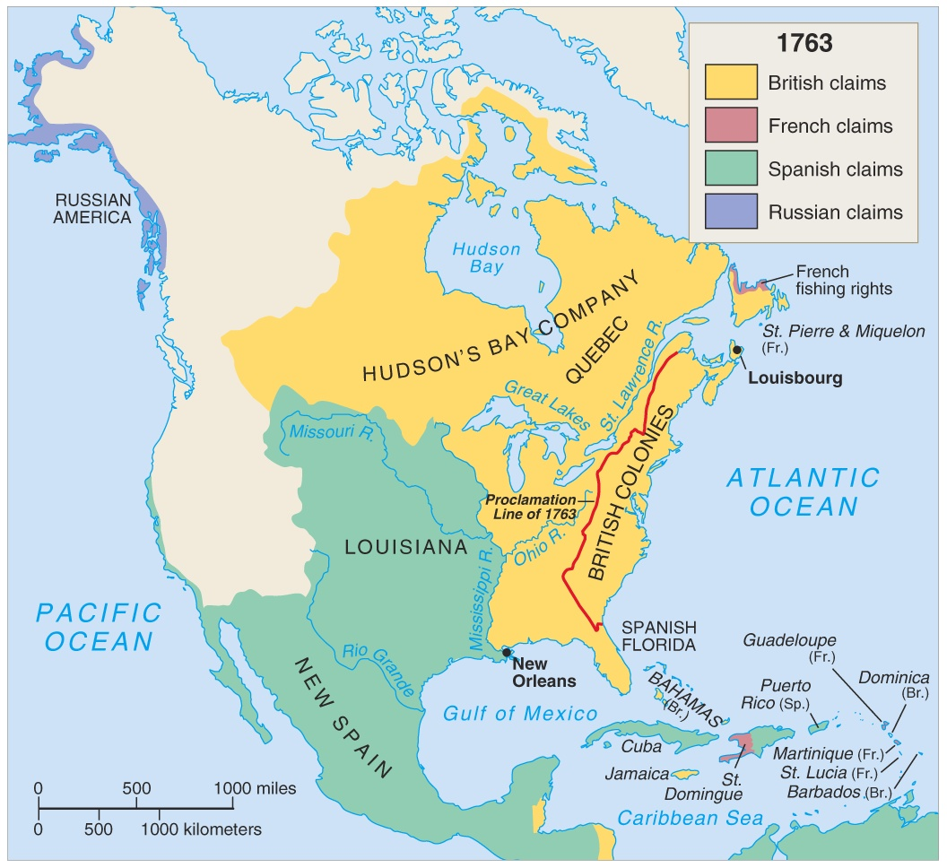
North America-1763

Slide 10
Effects of the War on Britain?
1. It increased her colonial empire in the Americas.
2. It greatly enlarged England’s debt.
3. Britain’s contempt for the colonials created bitter feelings.
Therefore, England felt that a major reorganization of her American Empire was necessary!

Slide 11
Effects of the War on the American Colonials
1. It united them against a common enemy for the first time.
2. It created a socializing experience for all the colonials who participated.
3. It created bitter feelings towards the British that would only intensify.

Slide 12
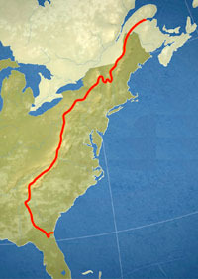
The Proclamation of 1763
The line is the Proclamation of 1763 -Appalachian Mountains were the Created by King George in order to create a temporary western boundary for the colonies
Why? To prevent another war
This angered many colonists who were already living in the area, or who have recently purchased land in the area
Friction between the colonies and Great Britain
Notes:
To prevent more fighting King George halted settler’s westward expansion
These colonists land claims were now not recognized
Recognized Indian’s right to land

Slide 13
After the French and Indian War
The British victory over the French was a devastating blow to the Native Americans of the Ohio River valley
NA lost their French allies and trading partners
NA began to trade with the British but saw them as enemies
The British raised prices of traded goods and unlike the French refused to pay Native Americans for the use of their land
Worst of all, British settlers began moving into the valleys west of Pennsylvania

