Slide 1
Sectionalism before war

Slide 2
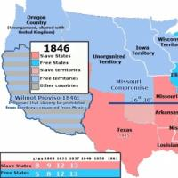
Slavery in the new territories
Wilmot Proviso
Introduced by Pennsylvanian Democrat David Wilmot
Slavery would not be exist in any territory acquired from the war with Mexico (Mexican-American War)
House approved this, but Senate rejected it

Slide 3
California
Enters the Union as a free state, causing alarm for the South
President Zachary Taylor supported the admission of California and said the South could counter abolitionism more effectively if they left slavery up to each territory (popular sovereignty) and not Congress

Slide 4
Answer the following question found under the box
What type of state was California?
Who did President Taylor say should decide if a state was free or slave?

Slide 5
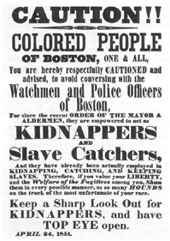
Fugitive slave act
Fugitives not permitted trial by jury
Could not testify on their own behalf
Just a statement from the slave-owner was needed for a slave to be returned
$10 offered when a slave was returned
Those found helping a slave had to pay a $1,000 fine and serve six months in prison

Slide 6
Answer the following question found under the box
What area of the country would approve of the Fugitive Slave Act? What area would not approve?
Who is the poster intended for?
What may happen if they are caught?

Slide 7
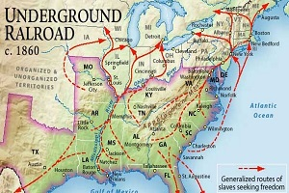
Fugitive slave act-Responses
Some Northerners organized committees to send endangered African Americans to Canada via the Underground Railroad
Some Northern states passed Personal Liberty Laws—forbade the imprisonment of runaway slaves and guaranteed they would have jury trials

Slide 8
Fugitive slave act-Responses
The Underground Railroad developed
It was run by free African Americans and white conductors, which hid fugitive slaves in secret tunnels
Harriet Tubman, known as Moses-helped 300+ slaves through the RR

Slide 9
Answer the following question found under the box
Why would the Underground Railroad need to be a secretive system?
What might happen if slaves were caught?

Slide 10
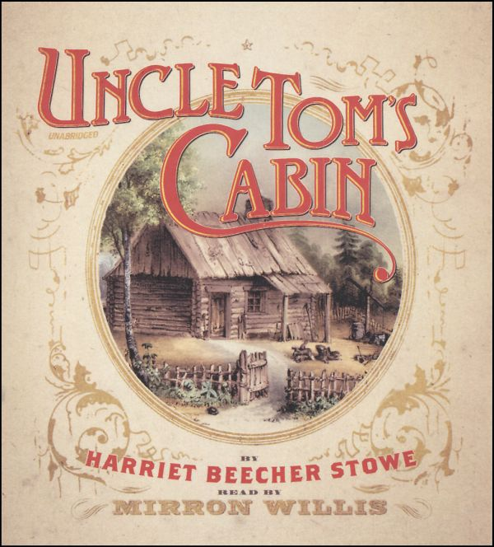
Fugitive slave act-responses
Uncle Tom’s Cabin
Book written by Harriet Beecher Stowe
Novel about the escape of a slave and the death of another
People believed this was a first hand account, NOT fiction (which it is)
Excited emotions in the North and South

Slide 11
Kansas-Nebraska act
The Act was proposed by Stephen Douglas
He proposes a bill that will divide the land into two territories: Kansas and Nebraska. This would repeal the Missouri Compromise, and allow popular sovereignty (the people of the area vote and decide) the issue of slavery

Slide 12
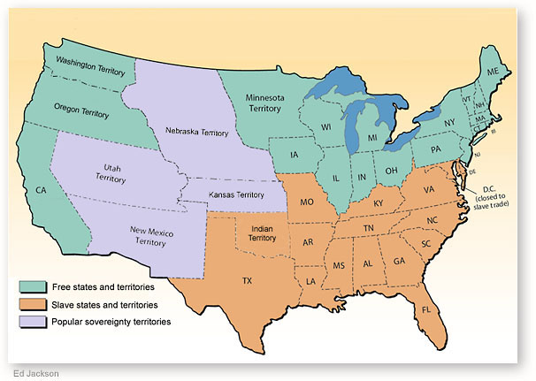

Slide 13
Kansas-Nebraska act
After the Kansas-Nebraska Act passed, individuals from both sides come pouring into Kansas to strengthen their numbers and their cause
In 1855, Kansas had enough settlers to hold an election
“Border Ruffians” from Missouri come in to throw the election (vote for their side even though they do not live there), and they succeed

Slide 14
Bleeding kansas
Anti-slavery settlers founded the town of Lawrence, KS
Pro-slavery grand jury condemned Lawrence inhabitants as traitors and called on the local sheriff to arrest them
Called the “Sack of Lawrence”
Pro-slavery posse of 800 men came into Lawrence, burning down the anti-slavery headquarters, destroying 2 newspapers printing presses, and looting houses and stores

Slide 15
Bleeding Kansas
John Brown said God called him to fight slavery, so he and his followers pulled five men from their beds and killed them with swords in Pottawatomie Creek
Dozens of incidents in Kansas followed, leading to the nickname “Bleeding Kansas”

Slide 16
Sumner-brooks incident
MA Senator Charles Sumner gives an impassioned speech for 2 days
He verbally attacks his colleagues for supporting slavery—particularly harsh on Andrew Butler of SC
Congressman Preston Brooks comes over to Senate chamber and beats Sumner over the head with his cane in order to protect Butler’s honor (Brooks’ uncle)

Slide 17
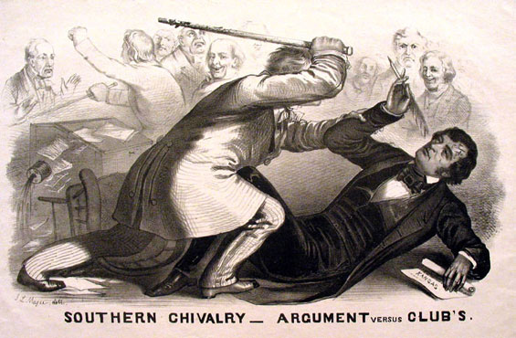

Slide 18
Answer the following question found under the box
This incident is known as the Sumner-Brooks incident. What does this incident show us about how people feel about slavery?

Slide 19
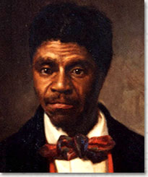
Dred Scott v. Sanford
1856, Dred Scott was taken above the Missouri Compromise line by his slave owner
They lived for four years in Illinois, a free state, and returned to Missouri where Scott’s owner died
He claimed that he had become a free person when they lived in Illinois

Slide 20
Dred scott v. sanford
SCOTUS rules that slaves did not have the rights as citizens and Scott was in Missouri, a slave state, when he began the law suit
SCOTUS also ruled that the Missouri Compromise was unconstitutional because Congress could not forbid slavery in any part of the territories because doing so interfered with slaveholders’ PROPERTY
Made the North angry and the South felt slavery had been extended
Supported by proslavery forces
Further diminished slaves rights
Slavery may be spread indefinitely

Slide 21
Answer the following question found under the box
Why did Scott believe he was a free man?
According to SCOTUS, slaves are not citizens. If slaves are not citizens, what are they?

