Slide 2
Welcome back to American History 1!
Please sit in the same spots as last class.
Please have out your Activity #1 from last class.

Slide 3
Today’s Goals
Finish all 3 activities from the Voyages of Discovery Choice Board (44 minutes)
Colombian Exchange Notes/Sort (20 minutes)
Invasive Species Articles (20 minutes)
Exit Ticket (6 minutes)

Slide 4
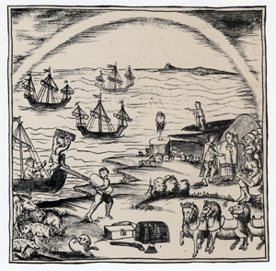
The “Columbian Exchange”
Columbian Exchange: interaction between the “Old World” (Europe) and “New World” (Americas).
Europeans brought diseases (smallpox, malaria, and measles) which wiped out thousands of Native Americans.
Within 50 years of Columbus’s landing, only one in 10 Native Americans still survived.
Spanish sailors unloaded various European goods in the New World.

Slide 5
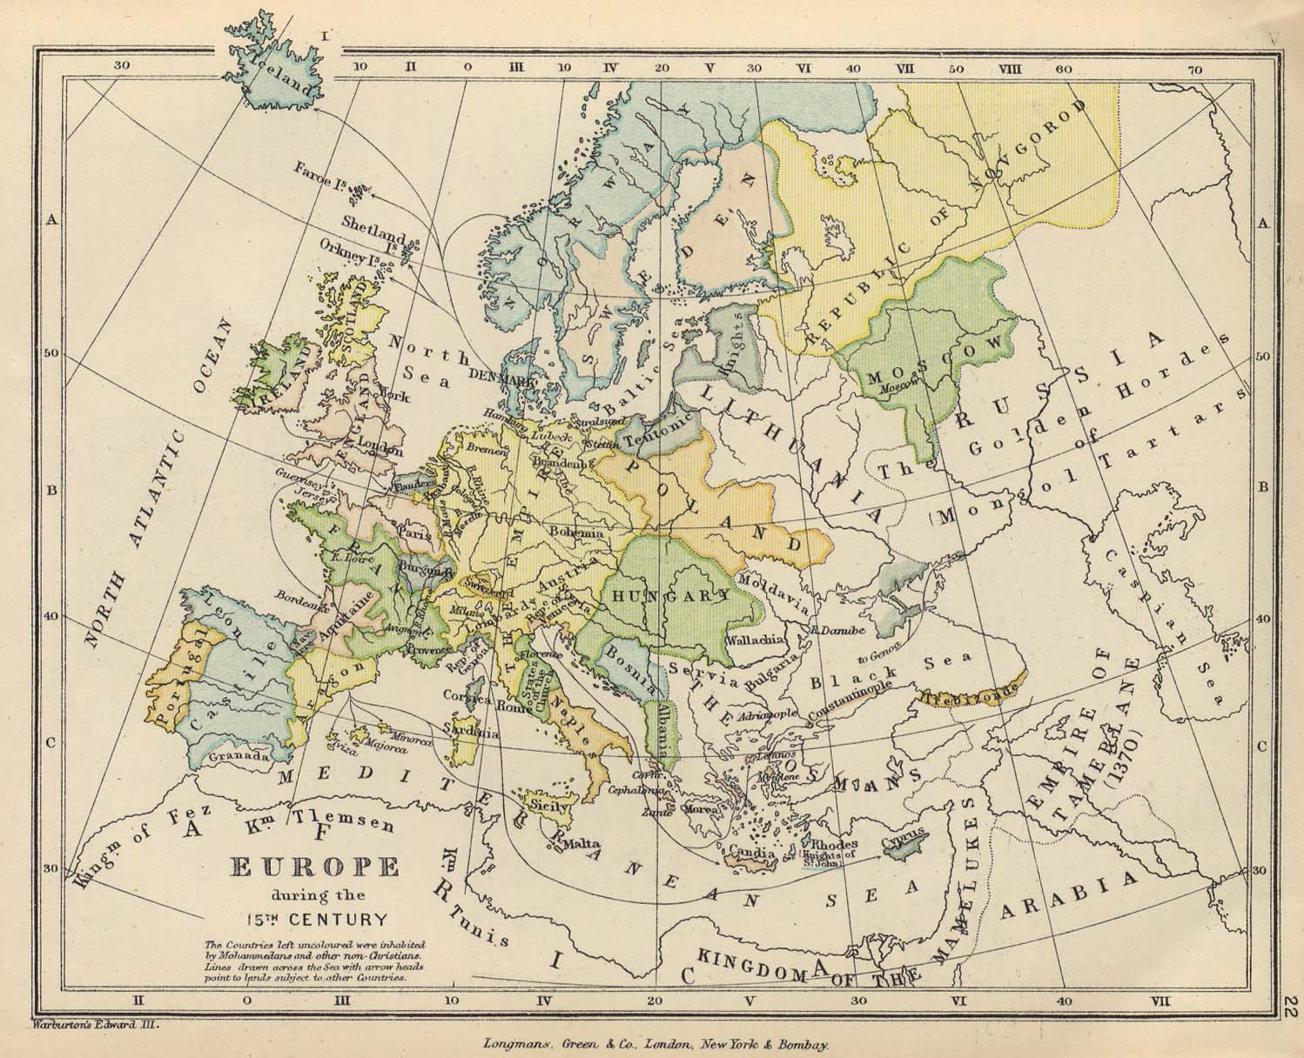
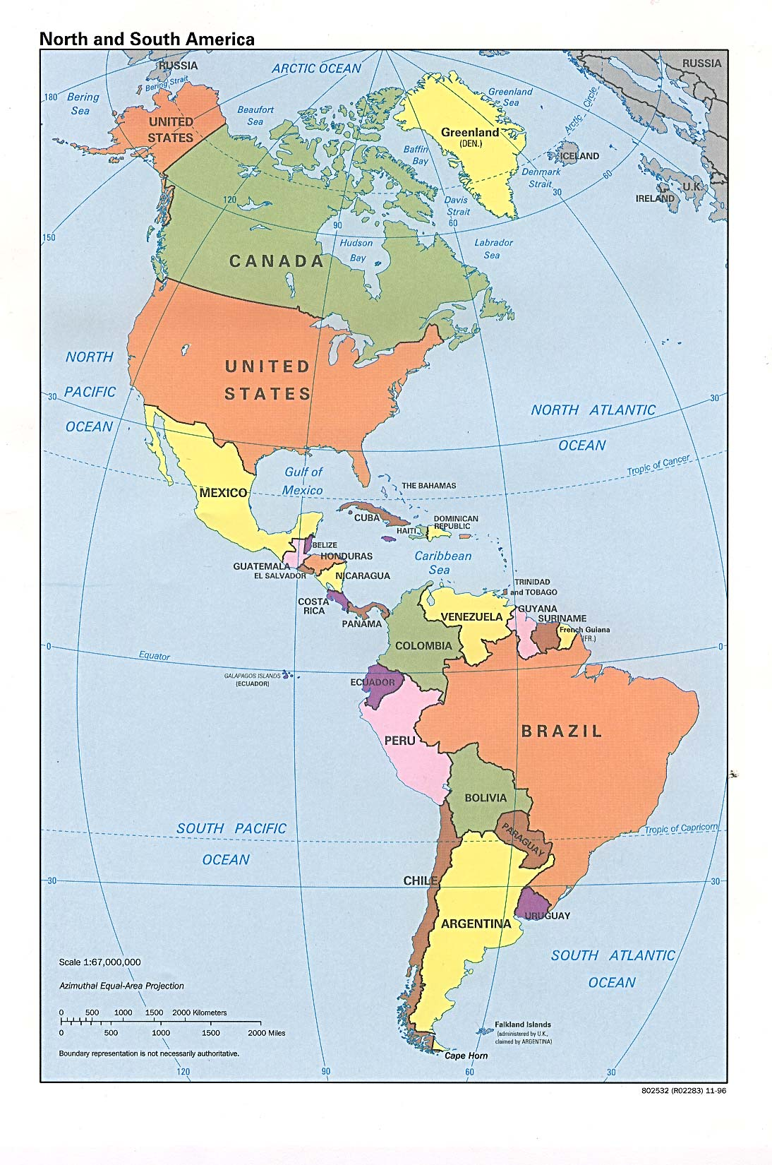
AMERICAS RECEIVED (New World) | COLUMBIAN EXCHANGE | EUROPE RECEIVED (Old World)
FOOD SUGAR, WHEAT, RICE, CITRUS FRUITS, TEA, COFFEE, BANANAS, OKRA, BARLEY, OATS, WINE GRAPES |  | FOOD CORN, WHITE POTATOES, PUMPKINS, TOMATOES, CACAO, STRAWBERRIES, QUININE, TOBACCO
ANIMALS TURKEYS, GUINEA PIGS, RATTLESNAKES, BUFFALO, RACCOONS |  | ANIMALS TURKEYS, GUINEA PIGS, RATTLESNAKES, BUFFALO, RACCOONS
DISEASES SMALLPOX, MEASLES, INFLUENZA |  | DISEASES SYPHILIS
RELIGION CHRISTIANITY
WEAPONS AND TOOLS GUNS AND IRON TOOLS

Slide 6
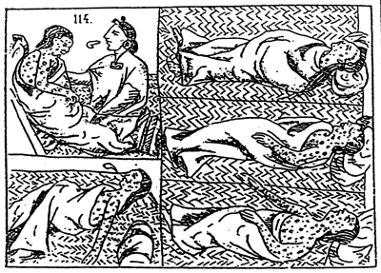
Disease played a major role in the colonizer’s success
Prior to European arrival as many as 50 million people lived in the Americas
Although smallpox, measles, and influenza were widespread throughout Europe, the disease had never infested North and South America
It is believed that as many as 90 percent of the native population was wiped out within 75 years of contact
Disease contributed greatly to European dominance

Slide 7
On your own
Read the article about an invasive species in North America.
Answer the questions in the box titled “Article #1”

Slide 8
Exit Ticket
On the back of your articles sheet, answer the following questions in at least 1 paragraph (5-7 sentences):
How can invasive species (think plant, animal, disease) affect your every day life? Think about things we discussed in class today that are not native to our country.
Has the introduction of new species throughout the world helped our hurt different
societies? Why?

