Slide 1
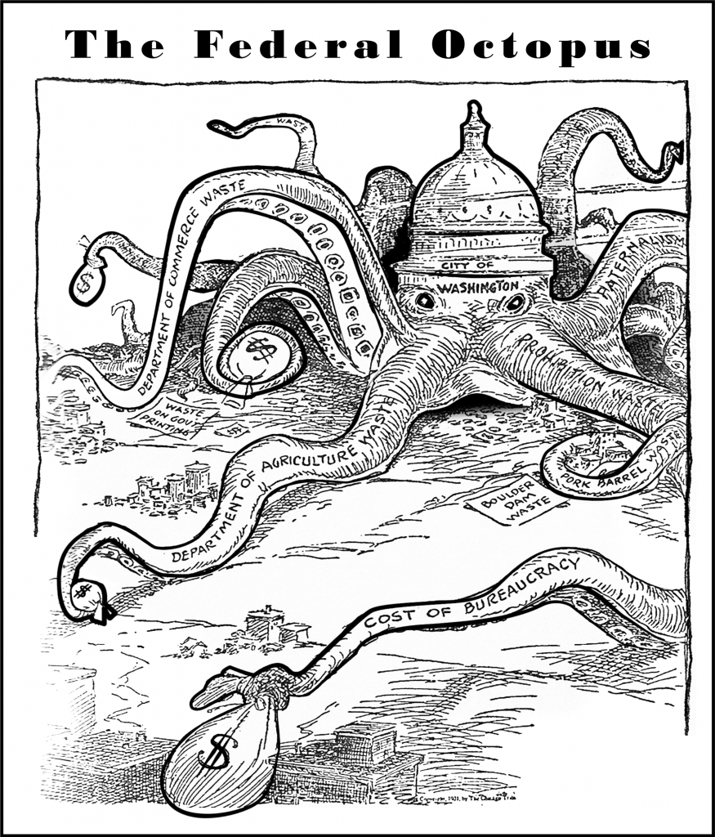
http://thefederaloctopus.com/?p=143

