Slide 1
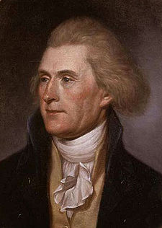
The Age of Jefferson


Slide 2
Jefferson cuts National Debt by:
taking money away from the army and navy rather than imposing more taxes.
increasing foreign trade
selling western land

Slide 3
1801: Chief Justice John Marshall
implementing the concept of judicial review (Marbury v. Madison)
insisting that federal laws are superior to state laws
broadly interpreting the Constitution—creates a strong central government
pushed for contracts that would limit state power to interfere in business

Slide 4
Louisiana Territory
Jefferson felt owning property was essential to survival and wanted the US to expand west.
The Spanish owned the Louisiana territory but had to give it up to Napoleon Bonaparte (France).
Napoleon was receptive to selling because his plan to conquer went awry and he needed money.
1803 Jefferson gets land from Mississippi River to Rocky Mountains. (828,000 miles for $15 million)
To explore the land, Jefferson sent Louis and Clark.
Jefferson placed an embargo on Britain which bankrupted American merchants, farmers and sailors. The British found other markets in South America.

Slide 5
