Slide 1
+
7.2 African Americans and the War

Slide 2
Emancipation Proclamation
+
Lincoln’s main goal was to restore the Union, not free the slaves
Emancipation comes after the Battle of Antietam on September 22, 1862—does not apply to border states.
Lincoln received criticisms from Congress and abolitionists.
Only frees slaves in the Confederacy.
For Northerners, it made the war about slavery and for southerners it ended any desire to end the war and rejoin the Union.
B/c of the proclamation, many African Americans in the north joined the Union army after Congress enacts the Militia Act allowing them into the military.

Slide 3
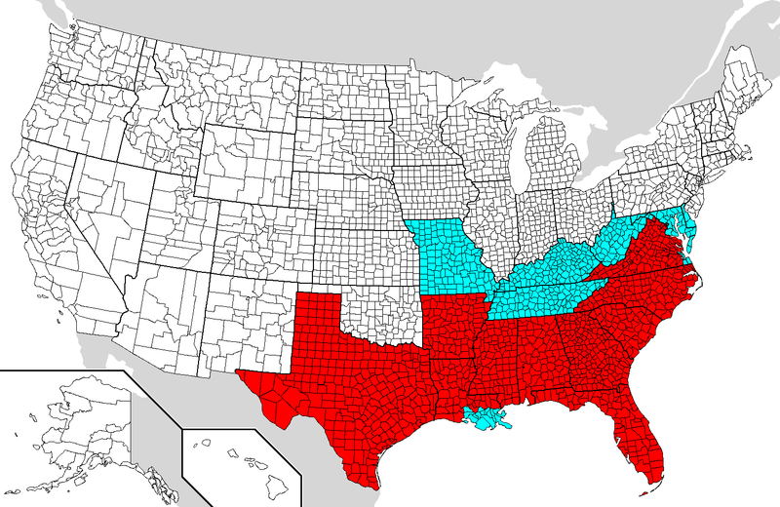
+
Areas covered by the Emancipation Proclamation are in light shade. Slave holding areas not covered are in dark shade.

Slide 4
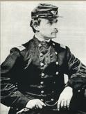
African Americans in the Military
+
54th Massachusetts—leader Robert Shaw—fought in Fort Wagner, Charleston, SC; gained a lot of respect for courage and discipline
Af. Amns faced discrimination—only being allowed to cook, clean, dig latrines, took 3 years to get equal pay.

Slide 5
Enslaved Africans in the South
+
Gave food to Union
Spies or scouts since they knew the terrain
Made own armies

