Slide 1
7.1 Resources, Strategies, and Early Battles

Slide 2
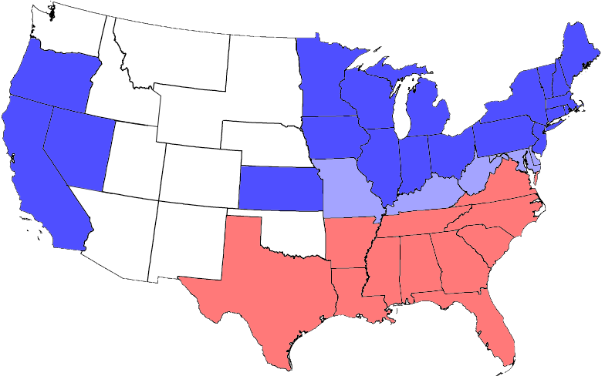
-Triangles represent Union states, including those admitted during the war;
-light shaded area represents Union states which permitted slavery (border states);
-Circles represent Confederate states.
-Unshaded areas were not states before or during the Civil War.

Slide 3
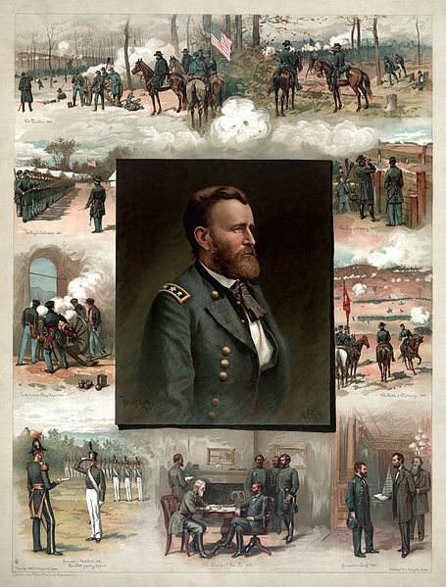
Advantages of the Union
More people
More industrial (coal, iron)
Immigrants to make ammunition, arms, uniforms, medical supplies
Larger Railraod network for moving troops/materials
Well-organized navy
Established government with a leader
Military leader: Ulysses S. Grant

Slide 4
Advantages of the Confederacy
More to fight for (morale)
Robert E. Lee was military leader
Did not have to destroy north, just avoid defeat

Slide 5
Union Strategies
Planned for quick victory
Two part plan dubbed “Anaconda Plan” by General Winfield Scott
1-Union would block southern ports (keeps South from $ and supplies)
2-Union forces go southward along Mississippi River and split the Confederacy

Slide 6
Confederate Strategies
Planned for a prolonged war
Militarily—preserve the army and break down Union soldiers willingness to fight
Politically-trade with Britain and France b/c the north cut them off from manufactured goods
Britain doesn’t aid b/c they don’t agree with slavery

Slide 7
Lincoln and Slavery
Border states: Missouri, Kentucky, Delaware and Maryland—all had slavery but hadn’t seceded
In Lincoln’s inaugural address he said he would not abolish slavery—kept border states in the Union
Lincoln’s main goal was to preserve the Union, not free the slaves

Slide 8
Early Battles of the Civil War
Bull Run—a creek near Manassas, Virginia
Confederates name their military leader Thomas J. Jackson “Stonewall Jackson”
Battle of Shiloh (TN)
25,000 troops die
Damaged Grant’s reputation
Union captures New Orleans
Battle on the Sea between Monitor (Union ship) and Virginia (C)
Both were iron ships—goodbye wooden ships!
Ended in a truce
Second Battle of Bull Run—Stonewall Jackson destroys Union
Known in the south as the Second Battle of Manassas

