Slide 1
Welcome back to American History 1!
Please grab your folder from the front table.
You should also have your notebook today, so please have that out on your desk.

Slide 2
Interactive Notebook Order
Page Numbers in the bottom right hand or left hand corner.
Page numbers will go on the back of the pages as well.

Slide 3
Interactive Notebook Order
For Interactive Notebooks, make sure you have a title and the date on the top of the page.
Our first 2 pages will act as our Table of Contents.
Please label these 2 page accordingly.

Slide 4
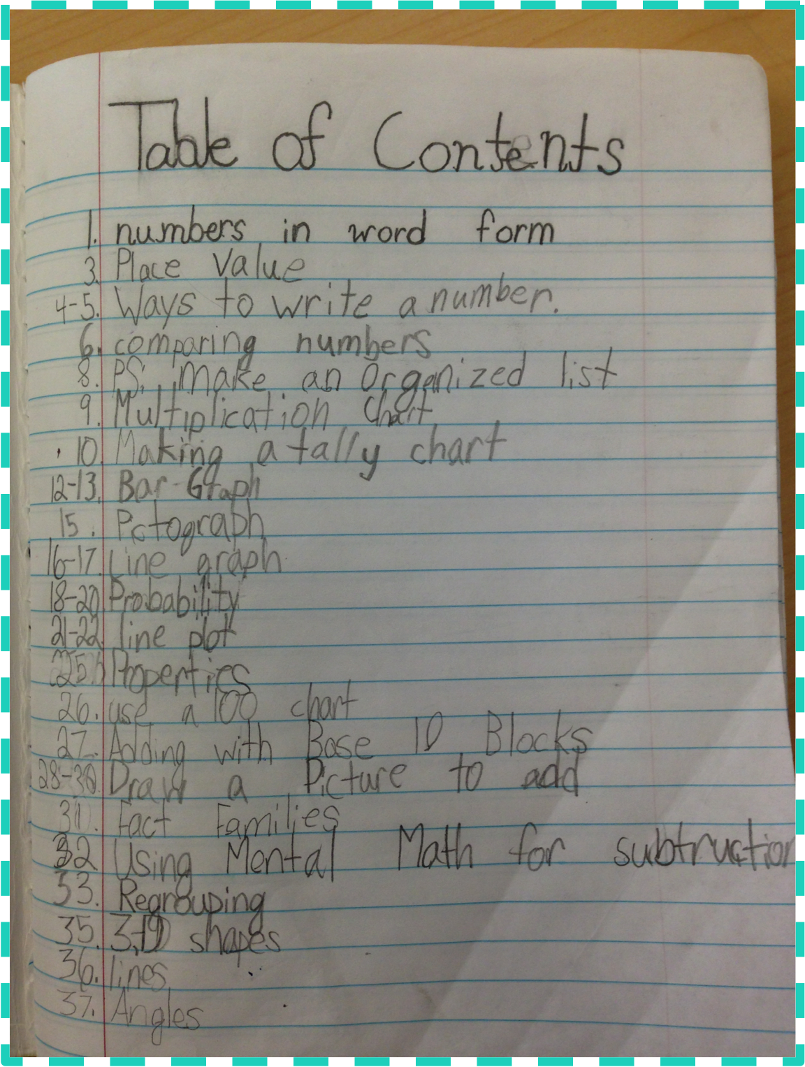

Slide 5
Interactive Notebook Order
p. 1 Procedures Notes
p. 2 Autograph Bingo
p. 3 American Dream Pie
p. 4 American Dream Quick Write
p. 5 INSPECT Chart
p. 6 The 6 Themes of American History
p. 7 USA Geographical Map
p. 8 Geographic Regions Foldable

Slide 6
Interactive Notebook Order
When glueing into the interactive notebook:
Use only 1-2 drops in each corner of the page. NO MORE, NO LESS
This allows us to not have to constantly buy new glue AND
This makes sure your pages are not sticky

Slide 7
Have out your INSPECT chart and envelope.
Please grab a pair of scissors and 1 glue stick or tube.

Slide 8
I: Want a better worldview? Choose a random roomie;
At houses of worship, women serve food for a higher purpose

Slide 9
N- Surfers flock to water as huge waves hit the west coast
Driven by climate change, cotton buyers look for alternatives
Wine country quake leaves bottle in shards

Slide 10
S
One woman’s lesson from living on the street
Golf courses provide oasis for low-income kids
“I am not an inmate-I am a man, and I have potential”
Pediatricians say schools should start later for teens’ health

Slide 11
P
Judge blocks enforcement of Louisiana abortion law
Miami struggles to embrace unaccompanied minors
Texas voter ID law goes to trial

Slide 12
E
Budget cuts threaten a unique Alabama prison education program
As casinos close, Atlantic City tries to pivot focus elsewhere
Bank of America settles with feds over mortgage meltdown

Slide 13
C
Immigrants keep children bilingual by schooling them at home
Agricultural investment should supply culturally acceptable food

Slide 14
T
Google and Amazon toying with the idea to use drones for delivery
Are food boats the next food trucks
Brainwave releases a prototype for a desktop microwave

Slide 15
What do we look for in each unit?

Slide 16
6 Themes of American I
On page 6 of your notebook, draw 6 large boxes
Leave space between each one for the title of the box.

Slide 17
Exploration, Settlement, Expansion
What are the factors that influence movement & the effects movement has on history?

Slide 18
Conflict and Compromise
How do the conflicts we face shape the rules, laws and regulations we have created?

Slide 19
Freedom, Equality & the Struggle for Power
How do we balance our ideas about how to live with the need for stability and order?

Slide 20
International Affairs and Foreign Policy
What are the push and pull factors that lead us to connect with other countries?
How does the world impact our decision-making?

Slide 21
Effects of War
What issues led to the war & our involvement?
How does war impact the people it involves?

Slide 22
Progress and the American Dream
How does the search for a better life differ amongst diverse populations?
How do new innovations & inventions help and hinder us?

