Slide 1
5.3 Effects of Territorial Expansion

Slide 2
Mexico’s Territory
Treaty of Guadalupe Hidalgo forced Mexico to give up the northern third of their country to the US
Creates bitterness between the US and Mexico
1853 US buys the Gadsden Purchase—area in southern Arizona and New Mexico in order to create a railroad across the continent

Slide 3
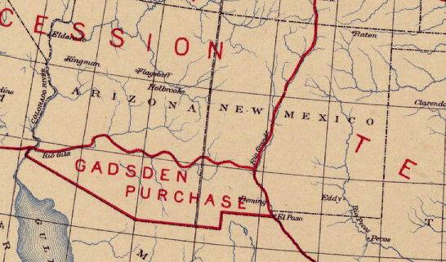

Slide 4
Wilmot Proviso
Wilmot Proviso banned slavery in any land bought from Mexico
b/c the Mexican government did not agree with slavery
Passed the House; not the Senate
Brought up in Congress for 15 years
Leads to increased North v. South tension

Slide 5
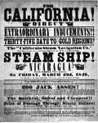
1849—California Gold Rush
80,000 people who were dubbed “Forty-Niners”
Some went by land, others by ship
About 25,000 laborers immigrated from China to California

Slide 6
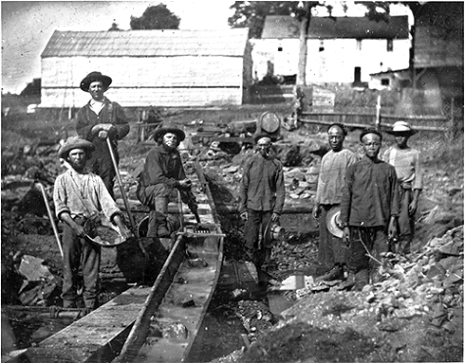

Slide 7
Mining Life
Crowded areas left miners prone to diseases
Poor unless you found gold
Left family behind

Slide 8
Consequences of the Gold Rush
Many natives died
Mob violence
Mexican Californians lost land
California applies for statehood but would it be free or slave? Tensions mount.
Stay tuned…

