Slide 1
5.1 Migrating to the West

Slide 2
Expansionist
Expansionists are people who want territorial growth
Expansionists gained support by using the phrase “Manifest Destiny”—the belief that God wanted the US to own all of North America for the white man.
Moving west took about 5 months and 2,000 miles
Most emigrants were farm people who faced hunger, exposure, disease or getting lost/stuck in the Sierra Nevada. (some resorted to cannibalism)
Mormons migrated to get away from religious persecution—led by Brigham Young

Slide 3
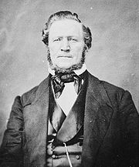
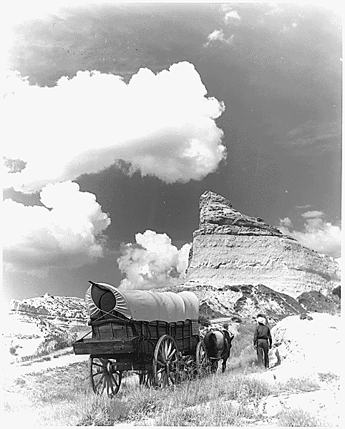
Brigham Young

Slide 4
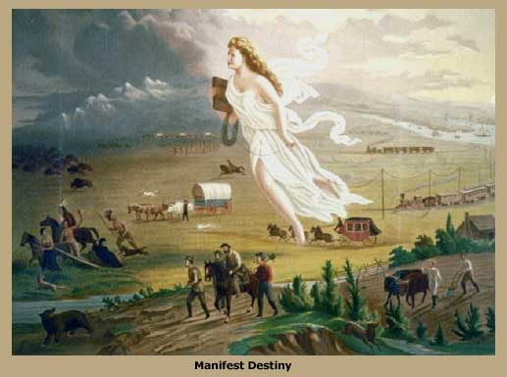

Slide 5
Expansionist;
Manifest Destiny;
Santa Fe Trail
Mountain Men;
Oregon Trail;
Alamo;
Lone Star Republic;
California Gold Rush;
forty-niners;
placer mining;
hydraulic mining
Brigham Young;
Stephen Austin;
Sam Houston;
James K. Polk;
Zachary Taylor;
Winfield Scott
Treaty of Fort Laramie;
Treaty of Guadalupe Hidalgo;
Gadsden Purchase;
Wilmot Proviso

