Slide 1
4.2 A Reforming Society
What were the main features of the school, penitentiary, and temperance movements?

Slide 2
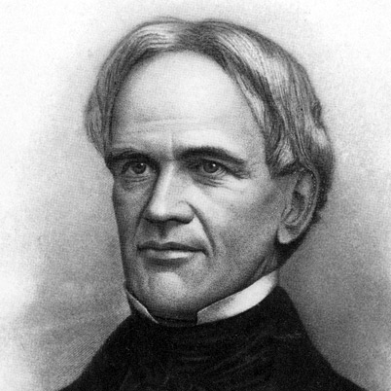
Education
Horace Mann creates first public schools in Massachusetts
Women become teachers
Specific schools and colleges are created for females

Slide 3
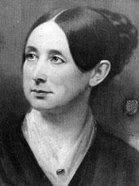
The Ill
Dorothea Dix: advocates for mental hospitals and prison reforms
fought against mental patients being placed with criminals
believed prisoners should be taught to repent and show sorrow
2 types of reforms for penitentiaries
urged to repent while they live in solitary confinement, work alone in their cell and exercise in individual yards
too expensive
isolation considered cruel
prisoners work with one another during the day in strict silence but slept in individual cells at night
many prisons followed this model

Slide 4
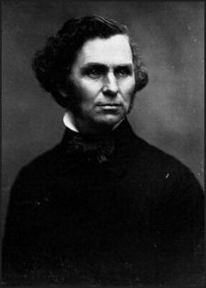
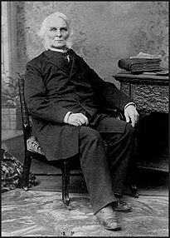
Temperance
Effort to end alcohol abuse and the problems it causes
Changes with alcohol occurred after Neal Dow passes the “Maine Law” which restricts the sale of alcohol
No alcohol means less money for federal government and citizens

