Slide 1
Charles Grandison Finney
4.1 A Religious Awakening
How did the Second Great Awakening affect life in the United States?

Slide 2
Second Great Awakening
Revivalists (mostly Protestant) want to bring people back to religion in order to secure the country’s future
Began 1820s
Had campouts called revivals
Led by Charles Grandison Finney who used evangelical strategies where you use strong emotions and hope to convert people
African Americans were welcomed at many revivals but usually made their own churches
Unitarians emerge arguing God should be seen as one, not as a trinity. Also believe in a strict interpretation of the Bible

Slide 3
Mormons and the Jesus Christ of Latter-day Saints are created by Joseph Smith
Joseph Smith

Slide 4
Catholics discriminated against because of poverty (mostly immigrants)
Jews discriminated against for being Jews
People tried to break away and form utopias
Famous utopia: Brook Farm (near Boston)
Tried to combine physical and mental labor
Lasted 6 years
Some became Transcendentalists
People could learn about the universe beyond senses
Listen to nature and your conscious
Famous: Ralph Waldo Emerson and Henry David Thoreau

Slide 5
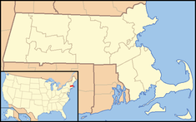
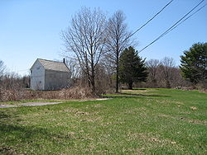
Brook Farm
Brook Farm today, the white house used to be a printing house

