Slide 1
3.5 CONSTITUTIONAL DISPUTES AND CRISIS
What major political issues emerged during the 1800s?

Slide 2
Tariffs: taxes on imported goods
North favored tariffs but south did not
1828 Congress adopts high tariff
Southerners call it the Tariff of Abominations because it was created to promote industry, not agriculture
John C. Calhoun—Jackson’s VP—opposed the tax and pushed for states to nullify the tariff based on constitutionality
1832 South Carolina prohibits the collection of the tax and threatens to secede from the Union if the fed gvmnt tried to force them to pay the tax
Calhoun resigned and became a senator
Daniel Webster—Congressman—who said
the Union is made up of the American people, not states
Jackson had the right to use troops as a means of enforcing federal law (Force Bill)
Congress reduced the tariff
Force Bill is nullified
Crisis of SC seceding is avoided

Slide 3
Second Bank of the United States
Jackson against the bank
Wealthy people liked it because it created a stable paper currency
People who supported the bank were called Whigs, led by Henry Clay
Whigs are nationalists who want a strong central government
Martin van Buren becomes president in 1836
Federal gvmnt stopped taking paper money to buy federal land so the value of land dropped dramatically
Businesses and banks go under; wages drop 30% and 33% population lost their job

Slide 4
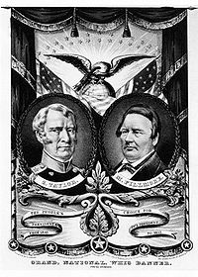
Other
1840: William Harrison (Whig) wins presidency
Dies of pneumonia a month later
John Taylor becomes president and rejects all Whig legislation
Whig party candidates Zachery Taylor and Millard Fillmore

