Slide 1
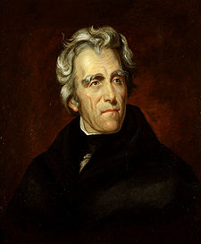
3.4 Democracy and the Age of Jackson

Slide 2
1824 Election
All four candidates were Democratic-Republicans
Voters had to look into their individual views
Electoral vote split so much that nobody had the majority so the House of Representatives had to decide who won (12th Amendment)
John Quincy Adams beats out Henry Clay, Andrew Jackson, and William Crawford
Splits the Democratic-Republican Party
Those who supported Jackson called themselves Democrats

Slide 3
Election of 1828
Andrew Jackson—strong nationalist—wins
Campaign manager: Martin Van Buren
Jackson:
Weak federal government
No interference with slavery
Rewarded people with gvmnt jobs who were Democrats—spoils system
States tried to remove Natives—Jackson supported this
SCC Worcester v. Georgia—Georgia seizing land from Natives is unconstitutional; fed gvmnt has treaty obligations to protect Natives and fed law overshadows state
Indian Removal Act (1830): trading peacefully with Natives land in the South for land in the West
1838 US soldiers force Cherokees to walk west—Trail of Tears—4000 died on the journey

Slide 4
