Slide 1
3.3 An Era of Nationalism

Slide 2
General Information
Nationalism: a glorification of the nation
1816 Congress establishes the Second Bank of the US
Henry Clay was a huge motivating factor

Slide 3
Supreme Court Cases
McCulloch v. Maryland (1819): Congress can enact any law to achieve any duty in the Constitution
Gibbons v. Ogden (1824): Congress’ ability to regulate interstate commerce includes intrAstate commerce (within a state)

Slide 4
US Economy
US establishes a capitalist economy where individuals own the factors of production

Slide 5
Nationalism and Art/Literature
James Fennimore Cooper—the Leatherstocking Tales
The Hudson River School starts—school for artists—focuses on nature
Within art and literature the artist or writer would glorify his or her place of living to show the world where they are from

Slide 6
Monroe Doctrine
1823—foreign policy by President Monroe that pushed for Europe to stay out of the Western Hemisphere
Shows the US’s want for power

Slide 7
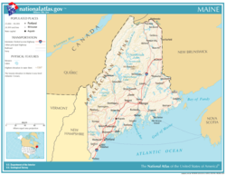
Slavery divides the Nation
FREE
Missouri Compromise
1820— drafted by Henry Clay
Northern district of Massachusetts would enter the Union as the free state of Maine and Missouri would be a slave state
Also drew line across the continent from Missouri to the west coast depicting slave states v. free states
Line drawn at 36 30’ parallel
SLAVE

