Slide 1
3.1 INDUSTRY AND TRANSPORTATION

Slide 2
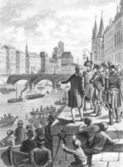
Key Transportation Developments in early 1800s
Turnpikes—roads where people pay tolls
Pay tolls to make them and for upkeep
Highways
Steamboat—Robert Fulton
Canals
railroads
Fulton showing his steamboat to Bonaparte 1803

Slide 4
Technology and Industrial Growth
1. Technology created
Water-powered textile mills—first one by Samuel Slater in New England
Sewing machines –Isaac Singer
Cotton Gin/interchangeable parts—Eli Whitney
Electronic telegraph—Samuel Morse
Factory mills—Francis Cabot Lowell —Massachusetts
“Lowell Girls”—women who lived in boarding houses together and worked together
2. Effects of Industrial Growth
Creates a division of labor and fast paced society
Didn’t need much skill = more jobs but less pay
First factories were thread or cloth, not finished clothing

Slide 5
Technology and Industrial Growth
2. Effects of Industrial Growth
Creates a division of labor and fast paced society
Didn’t need much skill = more jobs but less pay
First factories were thread or cloth, not finished clothing

